Slide 2
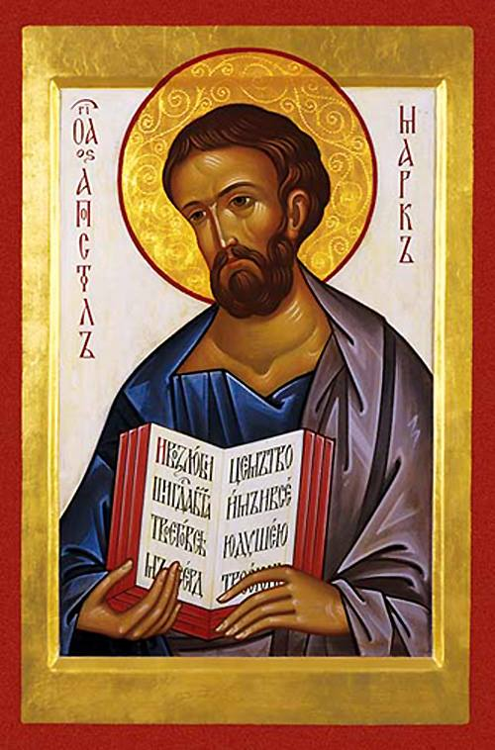
St. Mark From Mission to Martyrdom
Mark Oxbrow
Oxford Centre for Mission Studies
Oxford, UK

Slide 3
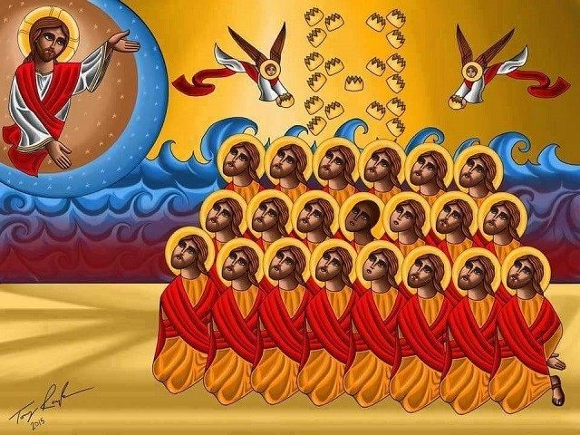
Christian Witness:
‘A life worthy of the Gospel of Christ’
(Philippians 1.27)

Slide 4
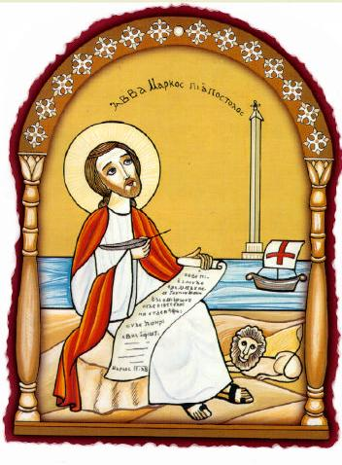
Μάρτυρας Witness Martyr

Slide 5
“But you will receive power when the Holy Spirit comes on you; and you will be my witnesses in Jerusalem, and in all Judea and Samaria, and to the ends of the earth.“
Acts 1:8

Slide 6
“But you will receive power when the Holy Spirit comes on you; and you will be my witnesses in Jerusalem, and in all Judea and Samaria, and to the ends of the earth.“
Acts 1:8
Not an
* Option
* Choice
* Response or
* Command
but a
Promise

Slide 7
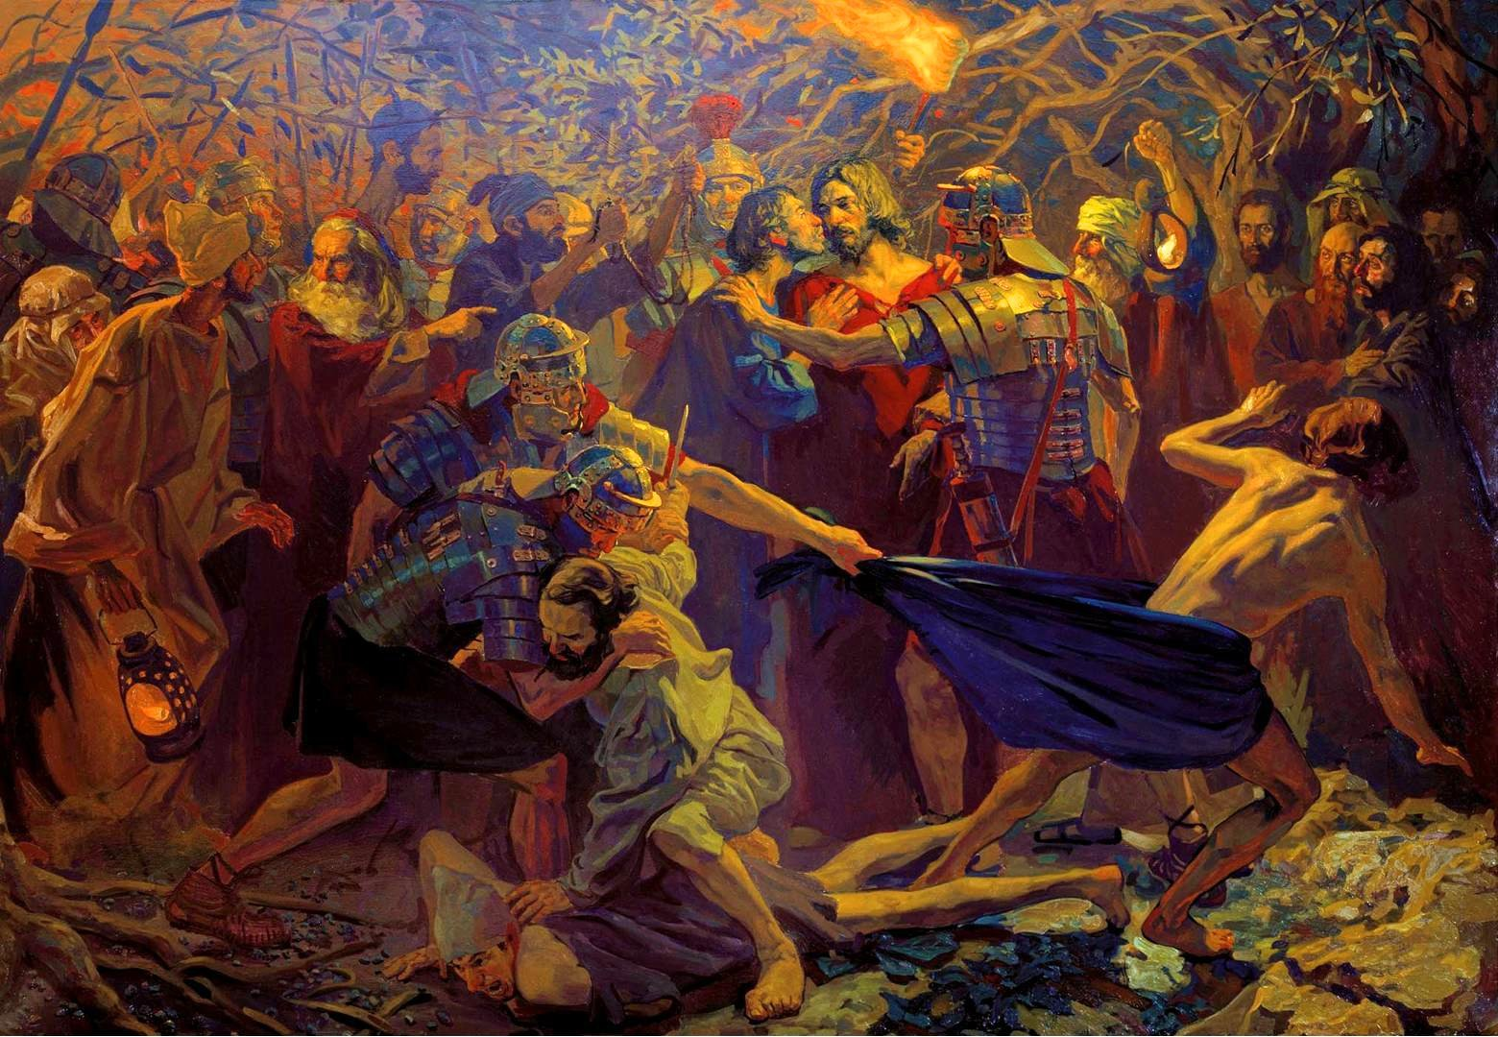
“A young man, wearing nothing but a linen garment, was
following Jesus.
When they
seized him,
he fled naked,
leaving his
Garment behind.”
Mark 14:51-52

Slide 8
“A young man, wearing nothing but a linen garment, was
following Jesus.
When they
seized him,
he fled naked,
leaving his
Garment behind.”
Mark 14:51-52
Mark
A follower of Jesus

Slide 9
“A young man, wearing nothing but a linen garment, was
following Jesus.
When they
seized him,
he fled naked,
leaving his
Garment behind.”
Mark 14:51-52
Mark
A follower of Jesus
An eye witness

Slide 10
“A young man, wearing nothing but a linen garment, was
following Jesus.
When they
seized him,
he fled naked,
leaving his
Garment behind.”
Mark 14:51-52
Mark
A follower of Jesus
An eye witness
A young man

Slide 11
“A young man, wearing nothing but a linen garment, was
following Jesus.
When they
seized him,
he fled naked,
leaving his
Garment behind.”
Mark 14:51-52
Mark
A follower of Jesus
An eye witness
A young man
Knowing vulnerability

Slide 12
The African roots of Orthodox faith and the orthodox roots of African faith

Slide 13
The African roots of Orthodox faith and the orthodox roots of African faith
“Classic African Christian teaching in the patristic period (100-750 AD) preceded modern colonialism by over a thousand years. Many young African women and men are now re-examining these lost roots. They are hungry for accurate information on their brilliant Christian ancestors.”
Thomas Oden

Slide 14
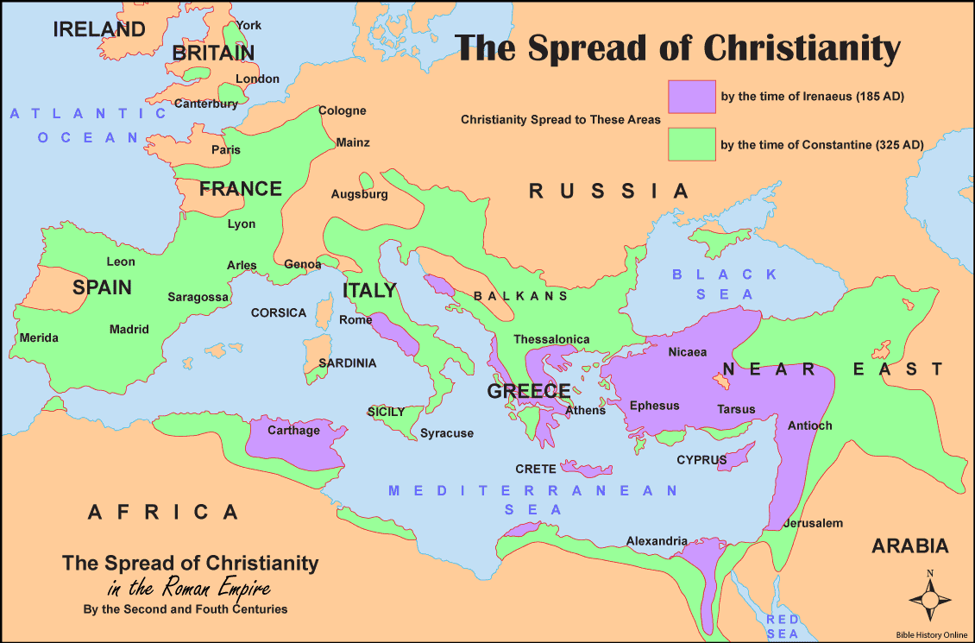

Slide 15
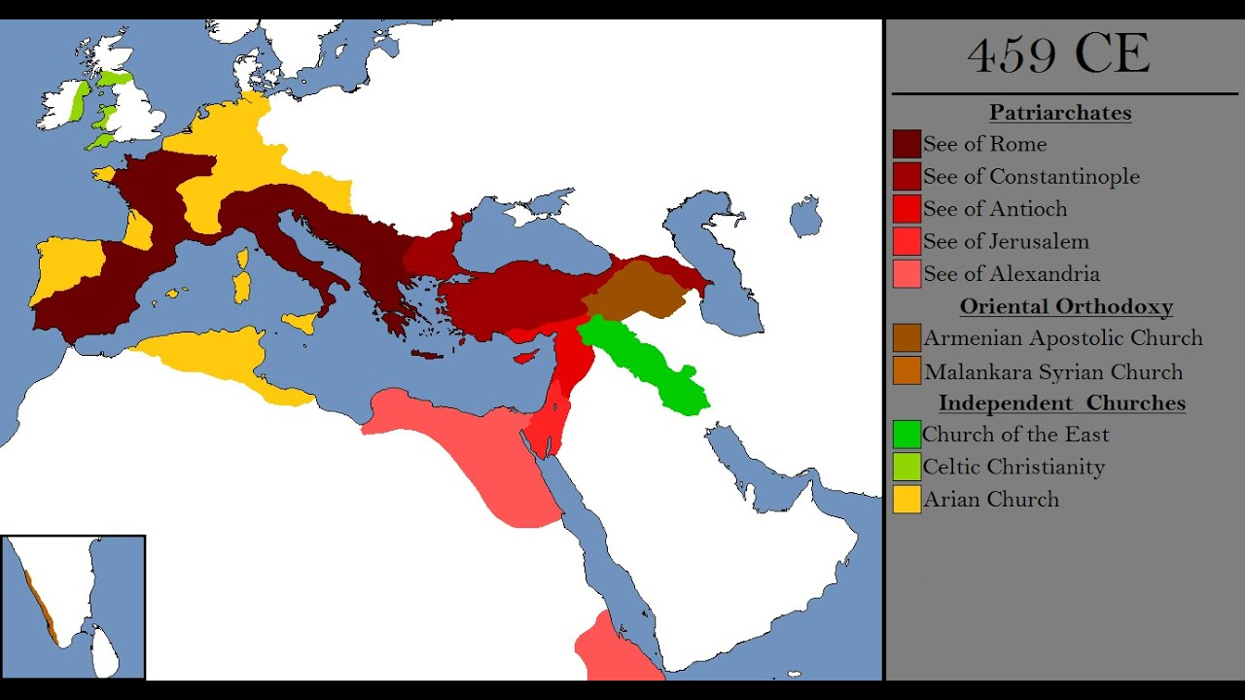
+?

Slide 16
+?
Cyrene

Slide 17
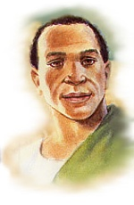
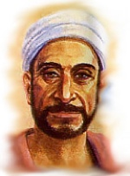
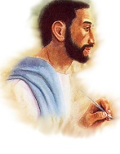
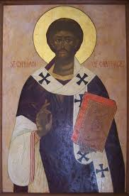
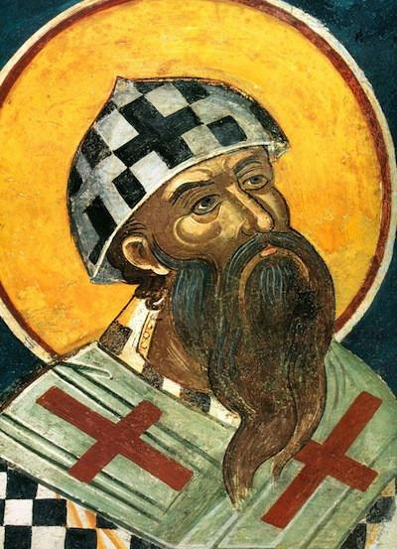
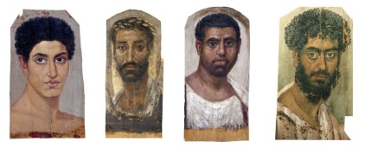
Augustine of
Hippo
Tertullian
Origen
Cyprian
Cyril of
Alexandria
Clement of Alexandria Marcus Minucius Felix
Optatus of Milevi

Slide 18
Mark the African

Slide 19
Mark the African
Cyrene today

Slide 20
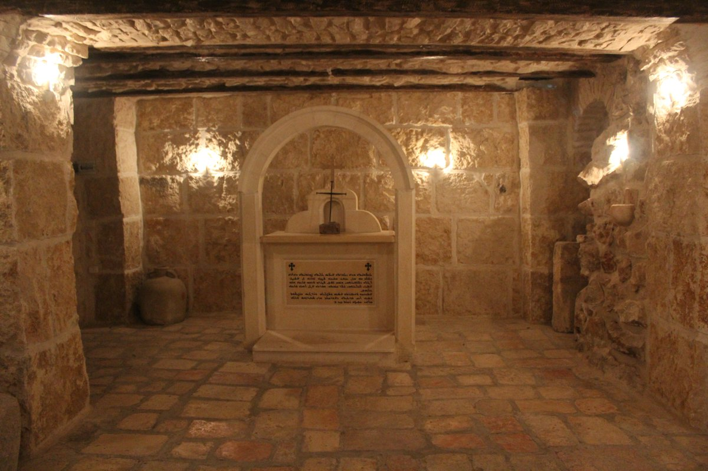
Mark the African
“This Saint [Mark] was born in Cyrene (one of the five Western cities, Pentapolis – in North Africa.”
Martyrium Marci
Son of a Jewish merchant
Displaced by civil unrest (5-15 CE)
Returns with his mother to Jerusalem
Living in a large house
His mother hosts the
Last Supper (Mark 14:14)
Pentecost gathering (Acts 2:1)
Peter’s escape from prison (Acts 12:12)

Slide 21
Mark the Migrant

Slide 22
Mark the Migrant
After being released from prison and fleeing to the home of Mary and John Mark, Peter departs (it seems very rapidly and probably for his own safety) to “another place”, which tradition suggests was Egypt , mirroring the earlier flight of the Holy Family to Egypt, but then in Acts 12:25 we are told that, following the death of Herod, “when Barnabas and Saul (Paul) had finished their mission, they returned to Jerusalem, taking with them John, also called Mark.” This implies two important things. Firstly, Paul did not waste his time in his place of sanctuary but was in mission there, and secondly that he had not gone there alone but with Barnabas and Mark.

Slide 23
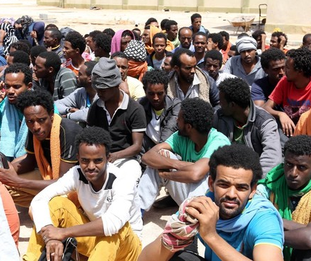
Mark the Migrant
Migrants
Are resilent
Know how to rely on God
Have cross-cultural skills
Can deal with authorities
Can find shelter
Build community
Preserve faith traditions

Slide 24
Mark the Youth

Slide 25
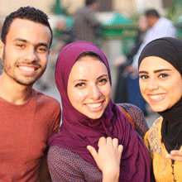
Mark the Youth
The fact that such a young man should have such an important role in the establishment of the Church, not only in Africa but also in southern Europe and at the gateway (in Antioch) to Asia is both countercultural for first century Middle Eastern society but also highly symbolic of the call that Jesus gave to place the child in the midst of our consideration of eternal matters.

Slide 26
Mark the Youth
2015

Slide 27
Mark the Witness

Slide 28
Mark the Witness
“[The angel] said to [the women], ‘Do not be amazed; you seek Jesus of Nazareth, who was crucified. He has risen, he is not here; see the place where they said him. But go, tell his disciples and Peter that he is going before you to Galilee; there you will see him as he told you.’ And they went out and fled from the tomb; for trembling and astonishment had come upon them; and they said nothing to anyone, for they were afraid.”
Mark 16:6-8

Slide 29
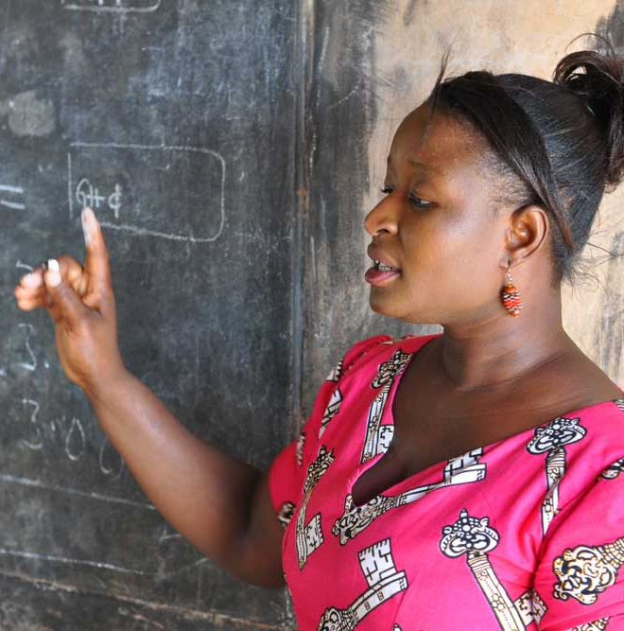
Mark and the Witness of Christian Living
For a more theologically nuanced rationale of this focus on the witness of Christian living we turn to Tertullian who links Christian living in an unbelieving world with the incarnation. He asserts that the Christians’ patient approach to life, accepting suffering and even martyrdom, and looking always to the needs of others, “attracts the heathen”, in the same way that the life of God incarnate in Jesus attracted the first disciples.
Tertullian

Slide 30
Mark the Witness
The thesis of Allan Kreider’s work is that the African church of the first three centuries grew because of the ‘habitus’, the ‘Christ-like’ behaviour and life-style of the Christian community which was both intriguing and attractive to those outside the faith. He maintains that the African church of those early years had no strategy for evangelism and little verbal proclamation of the gospel and yet it grew at a rate rarely seen in subsequent centuries.
Habitus
Life Witness

Slide 31
Mark the Companion & Ambassador

Slide 32
Mark the Companion & Ambassador
“The Father sent the Son to beseech, and to be his Ambassador unto mankind. When then He was slain and gone, we succeeded to the embassy; and in his stead and the Father’s we beseech you. So greatly doth He prize mankind that He gave up even the Son, and that knowing He would be slain, and made us Apostles for your sakes; so that he said with reason, “All things are for your sakes” (2 Cor. 4:15). “We are therefore ambassadors on behalf of Christ,” that is, instead of Christ; for we have succeeded to his functions.”
John Chysostom

Slide 33
Mark the evangelist of the Spirit

Slide 34
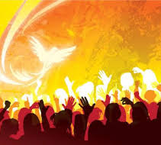
Mark the evangelist of the Spirit
We see here in Mark an aliveness to the spirit world. If we allow ourselves to be immersed in the ether of Mark’s gospel we find ourselves in a liminal place between the world of the supernatural powers – God, Satan and the spirits – and the human world of injustice, brutality and compassion, the two world inexorably entwined.

Slide 35
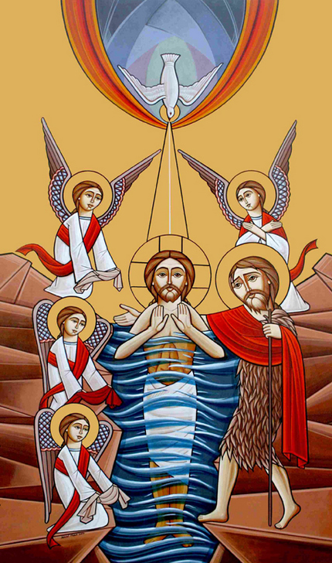
Mark the evangelist of the Spirit
Mark’s gospel stands as a challenge to the duality of much of contemporary Western theology which does not take seriously the ‘super-reality’ of the spiritual realm. As Orthodox theologians often remind us it is the physical realm that is temporal, temporary and passing and the spiritual realm which is eternally sustained in the life of the Trinity, but in the incarnate Lord the two cannot be wrenched apart.

Slide 36
Mark the Church Planter

Slide 37
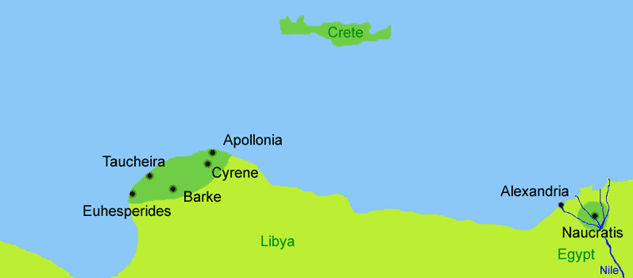
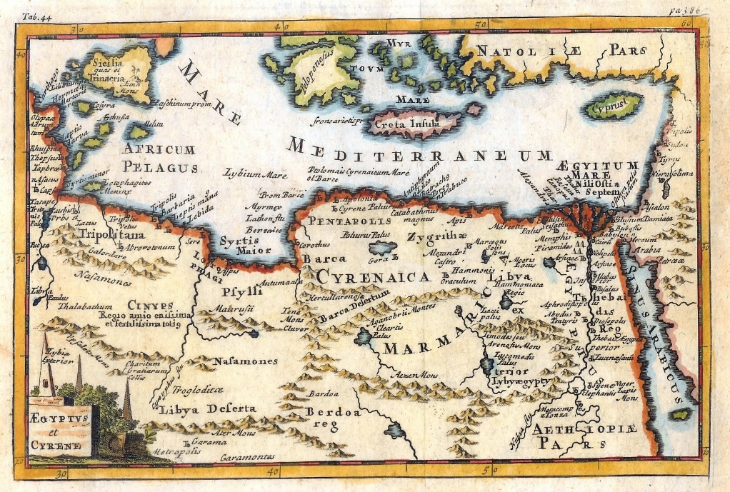
Mark the Church Planter
In Alexandria Mark “ordained a bishop (Anianos), three priests and several deacons to look after the congregation if anything befell him. He left Alexandria to Berce [in the Pentapolis], then to Rome, where he met St. Peter and St. Paul and remained there until their martyrdom in 64AD. Upon returning to Alexandria in 65AD, St. Mark found his people firm in faith and thus decided to visit the Pentapolis. There he spent two years preaching and performing miracles, ordaining bishops and priests and winning more converts. Finally he returned to Alexandria and was overjoyed to find that Christians had multiplied so much that they were able to build a considerable church in the suburban district of Baucalis”

Slide 38
Mark the Witness and Martyr

Slide 39
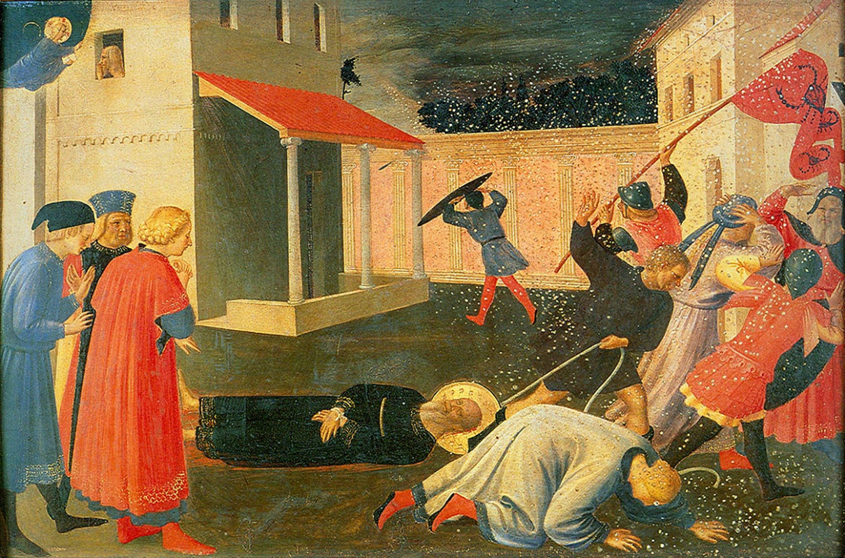
Mark the Witness and Martyr
Mark probably witnessed the martyrdom of
Jesus
Stephen
Peter
Paul
and many North Africans
The Maryrdom of Saint Mark
by Fra Angelico 1433
Museo di San Marco, Florence

Slide 40
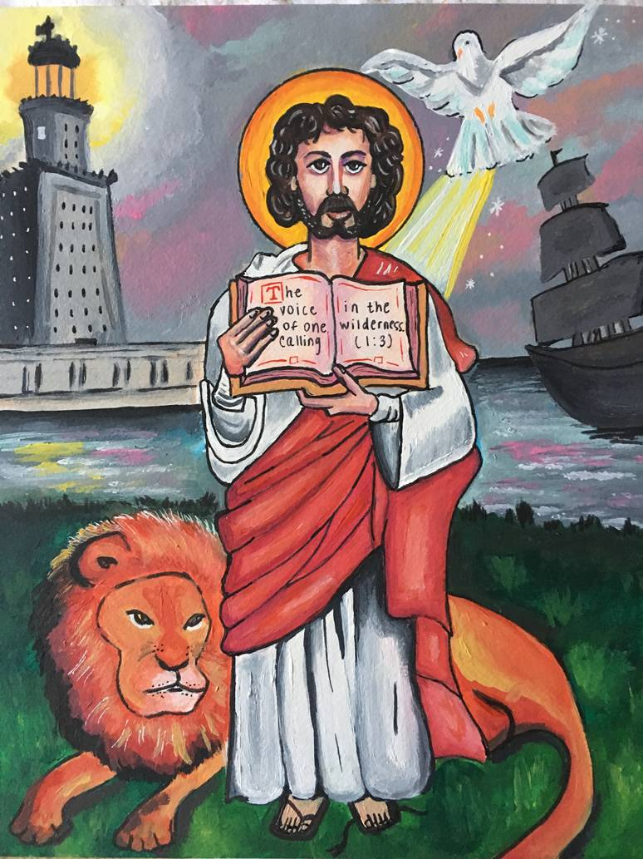
Mark the Witness and Martyr
“They will deliver you up to councils; and you will be beaten in synagogues; and you will stand before governors and kings for my sake, to bear testimony before them” in Mark is immediately followed by, “And the gospel must first be preached to all nations” There is no doubt here in Mark that the suffering and death which will ultimately come is an integral part of the witness to all nations.

Slide 41
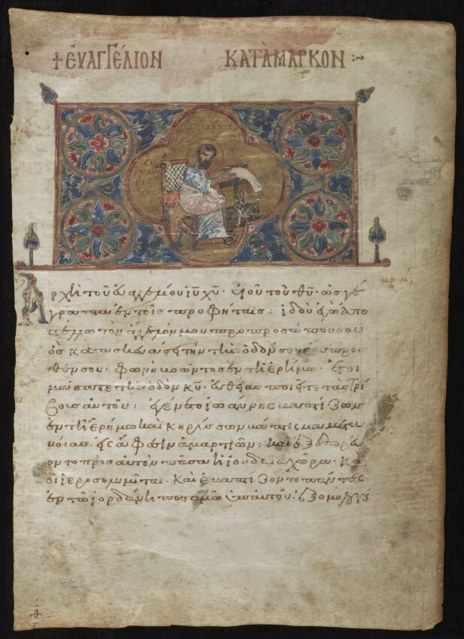
Mark the Witness and Martyr
“The beginning of the good news about Jesus the Messiah, the Son of God”
Mark 1:1
“Whoever loses his life for my sake and the gospel’s will save it”
Mark 8:35
“Truly this man was the Son of God”
Mark 15:39

Slide 42
Mark the Witness and Martyr
“The beginning of the good news about Jesus the Messiah, the Son of God”
Mark 1:1
“Whoever loses his life for my sake and the gospel’s will save it”
Mark 8:35
“Truly this man was the Son of God”
Mark 15:39

Slide 43
African Young Witness Martyr
Mark,
Bishop of Alexandria

Slide 44
The rapid spread of early African Christianity was due in part to the heartbreaking African history of martyrdom … For African believers the martyrs pointed to the continuity of the communion of saints ... They evoked a luminous awareness of their relation with esteemed ancestors …The readiness to die for the sake of the truth is intrinsic to baptismal faith. Thomas Oden
Mark,
Bishop of Alexandria

Slide 45
The meaning of the struggle of the early African martyrs begs to be understood in modern Africa. It was a countercultural, risk-laden, sacrificial, pre-Constantinian struggle for integrity in the face of over-whelming political power. … It was amid that period of martyrdom that the teachings of African orthodoxy were decisively refined. It was in that context that Africa gave birth to the enduring ecumenical doctrines of creation, providence, sin, atonement, resurrection and the church – its liturgy, eucharistic life, teaching and discipleship, refined by the fires of African experience. Living towards eternal life through death became the experiential basis for translating the Christian gospel into African terms Thomas Oden
Mark,
Bishop of Alexandria

Slide 46
A life worthy of the Gospel of Christ
Mark,
Bishop of Alexandria

Slide 47
© Revd Canon Mark Oxbrow
Oxford Centre for Mission Studies
Oxford, UK
moxbrow@ocms.ac.uk

