Slide 1
Why
Discipleship or Making Disciples
Matters
Dr. Joshua Bogunjoko

Slide 2
The state of things:
Many book, programs, methodologies and even movements... yet discipleship is not happening wholesale, and confusion persists.

Slide 3
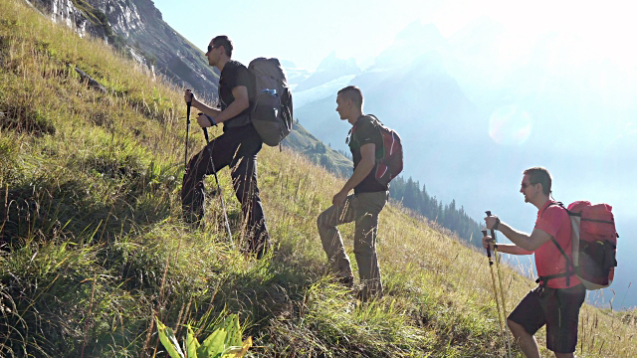
DISCIPLE-PILGRIMS
Journey together.
Mutually receive from and assist others.
Being and making disciples.
SIM Purpose statement

Slide 4
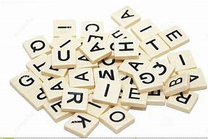
TERMINOLOGY
Imprecise language and the need for shared meanings
‘Disciple making’ and ‘discipleship’
Synonymous
Sequential
One Superior over the other

Slide 5
DISCIPLE:
“A disciple, mathetes, is a learner or follower— someone committed to a significant matter.”
-Bill Hull, Complete Book of Discipleship
“Disciples is a primary term used in the Gospel to refer to Jesus’ followers and is a common reference for those known in the early church as believers…. The term was used most frequently in this specific sense: at least 230 times in the Gospels and 28 times in Acts.”
-Michael Wilkins, Talbot School of Theology

Slide 6
DISCIPLE-MAKING:
Matheteusate: to make disciples (Matt 28:19)
- Deliverance (Repentance :turning from darkness to light Acts 26: 17-18)
- Development (Equipping: Ephesians 4:11-13)
- Deployment (Participation in works of service: Ephesians 4:12)
-Bill Hull, Complete Book of Discipleship

Slide 7
DISCIPLESHIP:
Widely accepted term for the ongoing life of a disciple.
Not purely biblical, but a derivative.
Ship: “the state of” or “contained in”
Discipleship: The state of being a disciple

Slide 8
WHAT WE CAN AFFIRM
What we can affirm and promote
What we ought not to affirm
This will lead us to a core concept that we can understand and embrace collectively, which will clarify why disciple-making matters in the church and missions.

Slide 9
“Discipling men and women is the priority around which our lives should be oriented.” - Dr. Coleman, The Master Plan of Discipleship
If this is so, have we wandered off into the weeds?

Slide 10
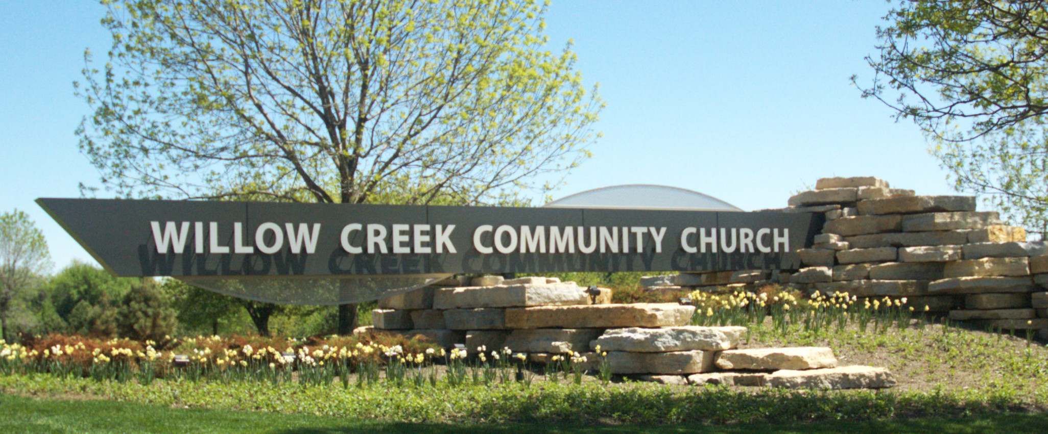
Make church or make disciples?
“If you make disciples, you always get the church. But if you make a church, you rarely get disciples.” - Mike Breen
Example:
Example:

Slide 11
Churches in some parts of the world are described as “a mile wide and an inch deep.”
Shallowness = a lack of disciple-making.

Slide 12
10 Reasons Disciple-making Matters
1. It is the model the Lord left for us.

Slide 13
10 Reasons Disciple-making Matters
2. It is the command of the Master.

Slide 14
10 Reasons Disciple-making Matters
3. It is the example of the early church.

Slide 15
10 Reasons Disciple-making Matters
4. It is the connection by which God’s Kingdom is spread and established.

Slide 16
10 Reasons Disciple-making Matters
5. It leads to growth, maturity, and effective participation in gospel work.

Slide 17
10 Reasons Disciple-making Matters
6. It prepares believers to express biblical compassion towards the needs of the world.

Slide 18
10 Reasons Disciple-making Matters
7. It prepares God’s people to confront the works of darkness.

Slide 19
10 Reasons Disciple-making Matters
8. It encourage fellowship and endurance in faith.

Slide 20
10 Reasons Disciple-making Matters
9. It is the only way to truly plant and build the church.

Slide 21
10 Reasons Disciple-making Matters
10. It brings glory to our Savior.

Slide 22
Three benefits of discipleship
It builds humility.
It unites us with fellow believers.
It equips us for faithfulness and faithful service.
-Trillia Newbell, Three Benefits of Discipleship

Slide 23
Our Intent:
to increase engagement and intentionality about being and making disciples.
to prioritize and catalyze a lasting ethos change about being and making disciples in the church and in global missions.
to highlight being and making disciples within the larger necessity for spiritual vitality in the church.
to demonstrate the personal, corporate and evangelistic aspects of being and making disciples.
to communicate the broad spectrum of what it means to be and make disciples - beyond programs, curricula, and events.
to dispel incorrect ideas about discipleship and disciple-making.
to foster unity around the principle that ‘making disciples’ is the community identity of Christ’s followers.

Slide 24
Challenges:
To develop, across many cultures and Christian traditions, a common understanding and priority of what it means to be and make disciples. Rejuvenating our vocabulary; removing errant ideas, jargon, and fads in popular Christian culture.
the perceived interchangeable nature of 'discipleship' and 'disciple-making'.
a definition of discipleship rooted in relationship and journey means that it will not be as simple to measure or package as the event- and program-based discipleship many have known.

Slide 25
Further discussion needed:
‘Convert' vs. 'disciple'? Can one be ‘born again in the Spirit,’ but not follow Christ as a disciple?
When does one become a disciple?
What defines maturity as a disciple?
Distinction between disciple-making, evangelism and church-planting?
What do we mean by “discipling” or “to disciple” others?
“Discipleship” vs. “disciple-making”?
What changes are needed in church and global missions to become more effective in being and making disciples?

Slide 26
Summary of affirmations:
Being and making disciples is the biblical mandate for every believer and is a foundational role of the people of God on mission with Christ.
Growing as a disciple is a lifelong process.
Disciple-making is about both evangelism and helping believers grow to maturity, not just one or the other.
Disciple-making is a relational process and the foundational intent of all relationships in every ministry.
Cont…

Slide 27
Summary of affirmations:
Cont…
5. Helping believers grow extends beyond initial establishing in the faith to increasing maturity and fruitfulness at all levels of growth.
6. Maturity as a disciple of Christ is not just about knowledge, but also about abiding in Christ, obeying in all areas of life and moving out in mission.
7. Making disciples includes sharing the truth of the gospel together while authentically modeling Christ.
8. Being and making disciples includes living and communicating God’s good news in the context of relationship, the broader community of faith, smaller groups and person-to-person.

Slide 28
SIM example:
A Disciple Maker’s Impact on generations!
A tribute to Miss Elizabeth Webb and others.

Slide 29
SIM Purpose:
Convinced the no one
should live and die
without hearing God’s good news,
We believe that He has called us
to make disciples of the Lord Jesus Christ
in communities where he is least known.

