Slide 1
Gospel & Mission: Theological Bases
C. Rosalee Velloso Ewell, PhD
World Evangelical Alliance, Theological Commission

Slide 2
How do Gospel & Mission shape our theologies and practices in an ever-changing world?
What difference does the good news make?
What comes to mind when I say ‘Mission’ or ‘Gospel’?

Slide 3
“Humans are homo narratus…”
H. Stephen Shoemaker

Slide 4
1. The particularity of the Gospel
The angel Gabriel didn’t visit any village, any virgin.
“In Jesus of Nazareth God contextualized himself… God does now shout his message from the heavens; God becomes present.”
C. René Padilla

Slide 5
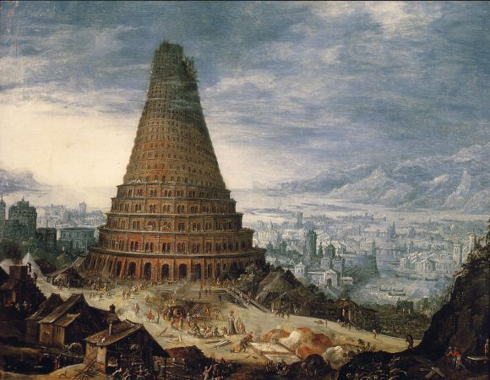
2. The universality of the Gospel as a challenge to our identities
In mission, the Good News disperses the fears:
• of uniformity
• of security

Slide 6
3. The Surprising Gospel
The gospel calls into question all our attempts to control, to lead as we see fit, to determine outcomes according to our desires or according to our understanding of how things should be. The gospel, by definition, resists any attempt to be colonized or to become empire.

Slide 7
4. The Missionary Gospel
• from the beginning, God’s people had a purpose – to show the nations through word, character and deed who was the One true God.

Slide 8
• As we are drawn by the Spirit into closer communion with Christ, we are also drawn closer to one another. This isn’t always easy. Matthew and Peter are not ‘natural’ friends.
Their friendship is only possible because of the good news of Jesus, which brings them together for the sake of mission, for the sake of telling the story of Jesus.

