Slide 1
Community of
the Cross of Nails
Coventry Cathedral
Supported by
Church Mission Society
(CMS)

Slide 2
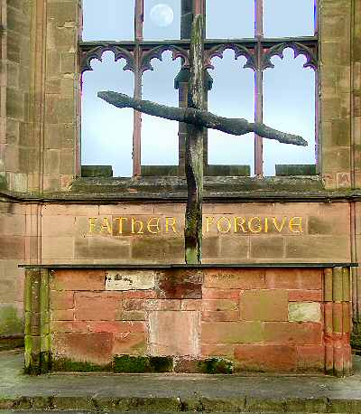
FATHER FORGIVE

Slide 3
Humility
Coming as sinner to sinner (Father forgive)
To listen and learn
To accept that Jesus is already there
To walk with
Allow yourself to be enriched

Slide 4
Love
In essentials, unity, In non-essentials, liberty In all things, love (St Augustine)
seeking the welfare of the other
Avoiding undermining allegiances
Trust – learning to be trusted
Trust – learning to trust
Not fearing the other
Confidence
Befriending – accepting friendship

Slide 5
Practical stuff
Joining in
Our centre – finding common interests
Teaching

Slide 6
“The nearer we come to Christ,
the nearer we are to each other.”
(Moltmann)

